Slide 1
1
신경회로망특론
지도교수 : 정성원교수님
연구실 : 빅데이터 & DB
이름 : 가상민

Slide 2
Project
2
Data sets
Model
Using the CNN
Water leak vibration data for water pipes in AI hub
Outdoor leaks,
indoor leaks,
machinery.Electrical sound,
environmental sound,
a normal sound ,
16.7 % 16.7 %
16.7 %
16.7 %
33.2%
Classification
problem
To determine whether there is a leak through the sensor-based automatic leak detection AI model.
sensor-based data
Goal
How

Slide 3
Data set
3
5 Class : Leak detection, data classification
Count
Outdoor leaks,
indoor leaks,
Machinery & Electrical sound,
environmental sound,
a normal sound ,
28.3 % 21.2 %
8.03 %
11.2 %
31.4%
21923 16591
6287
8775
24628
Total_Count
78204
광주광역시 설치 누수감지 센서 7,676대 (각화정동, 월산동, 산수동, 지원동, 광산구 일대) ․
금호건설 고흥 현대화 설치 누수감지 센서 3,441대 (전라남도 고흥읍, 호형면, 신정면 일대) ․
총 11,000개소 설치된 누수감지센서 대상 누수 감지 데이터 3만건 이상 추출
AI hub

Slide 4
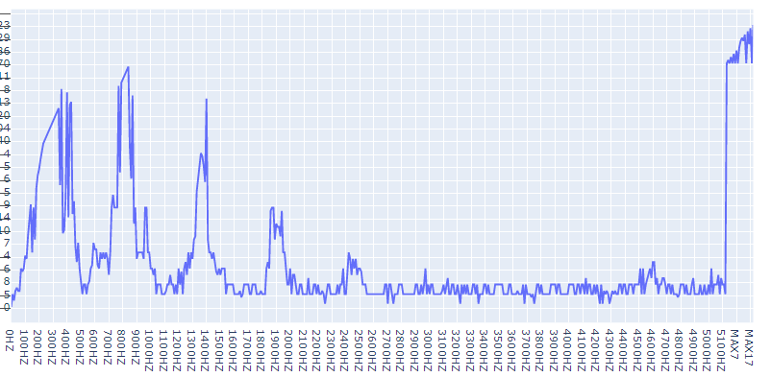
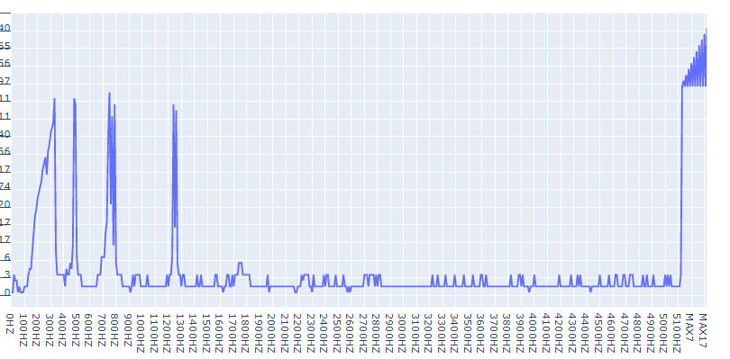
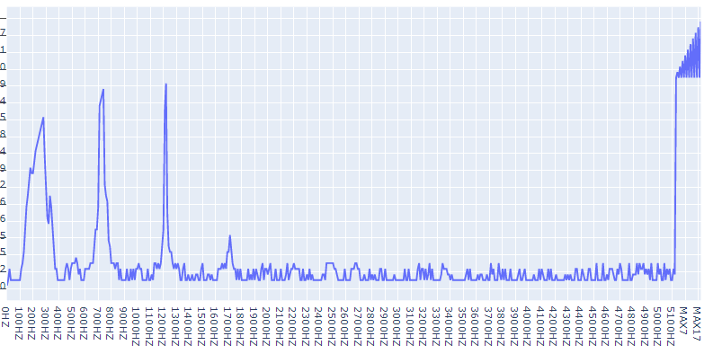
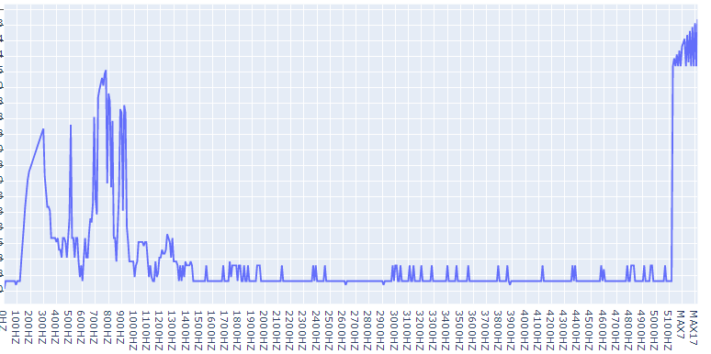
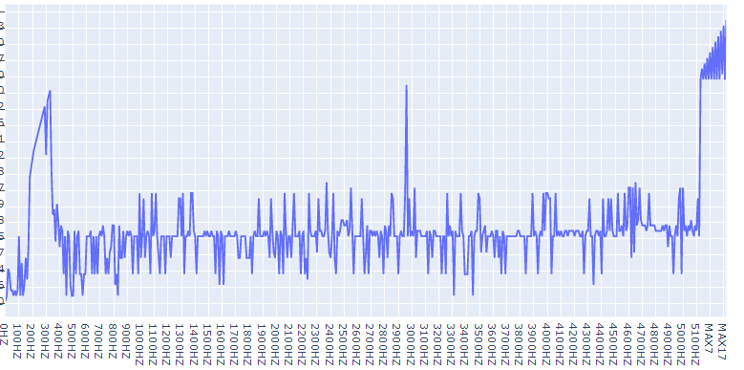
Data set
4
5 Class : Total number of sensor is 533
Outdoor leaks
indoor leaks
Machinery & Electrical sound
environmental sound
normal sound

Slide 5
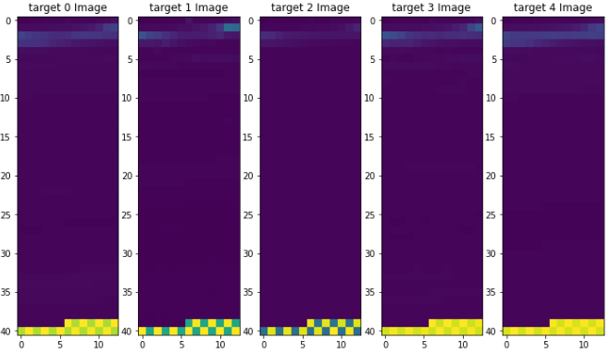
Data set
5
(41 * 13) 이미지
Machinery & Electrical sound
Outdoor leaks
indoor leaks
environmental sound
normal sound

Slide 6
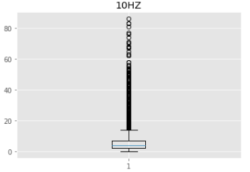
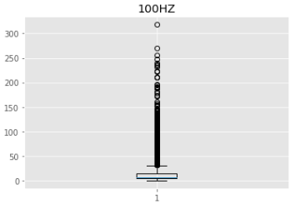
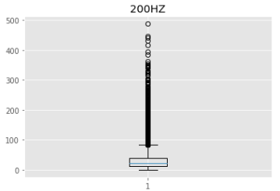
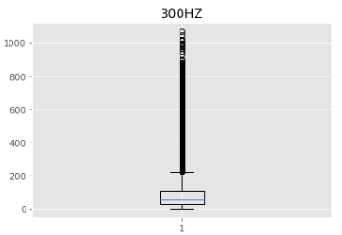
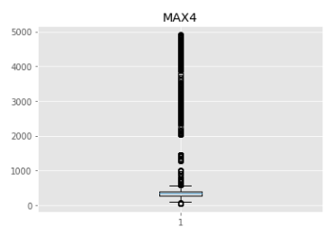





Data set
6
Outlier Detection
Distribution
10Hz
100Hz
200Hz
300Hz
Max4
0 ~ 80
0 ~ 300
0 ~ 500
0 ~ 1000
0 ~ 5000

Slide 7
Model
7
Using the CNN
1. Basic_CNN
2. Deeper than Basic_CNN
3. My_ResNet

Slide 8
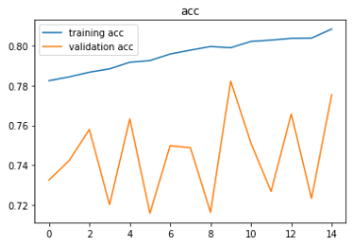
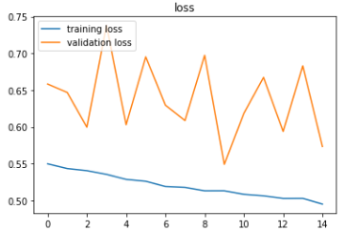
Model
8
Using the CNN
5 Layers
1. Basic_CNN
(2,2) 커널, 32 필터, padding = 1 // 43*15, relu
(1,1) 커널, 16 필터, padding = 1 // 44*16, relu
(4,4) 커널, 32 필터, padding = 1 // 46*18, relu
BatchNormalization()
pooling
F.C, softmax()
15회, 각 랜덤 train(0.8), test(0.2) 값으로 진행

Slide 9
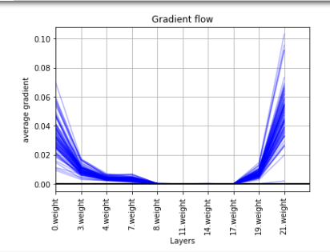
Model
9
Using the CNN
2. Deeper than Basic_CNN
(2,2) 커널, 32 필터, padding = 1 // 43*15, relu
BatchNormalization()
(1,1) 커널, 128 필터, padding = 1 // 44*16, relu
BatchNormalization()
Accuracy on validation set
Got 2299 / 2563 correct (89.70)
(4,4) 커널, 256 필터, padding = 1 // 46*18, relu
(3,3) 커널, 256 필터, padding = 1 // 45*17, relu
Accuracy on test set
Got 14076 / 15641 correct (89.99)
(3,3) 커널, 128 필터, padding = 1 // 45*17, relu
10 Layers
F.C (128 * 43 * 15) // 43 * 15
Linear(64, 64), relu
Total(75,641) train(60,000) test(15,641) validation(2,563)
Linear(64, 5), relu // 5 * 64

Slide 10
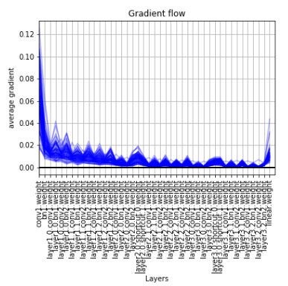
3 * 3 conv, (64, 64)
F∙C 1920 (64, 10, 3 )
Linear(1920, 5), relu # 64*10*3
3 * 3 conv, (64, 64)
Model
3 * 3 conv, (64, 64)
10
3 * 3 conv, (64, 64)
Using the CNN
3 * 3 conv, (64, 64)
3 * 3 conv, (64, 64)
3. MY_ResNet20
3 * 3 conv, (32, 64)
3 * 3 conv, (32, 32)
3 * 3 conv, (32, 32)
3 * 3 conv, (32, 32)
Accuracy on validation set
Got 2298 / 2563 correct (89.66)
3 * 3 conv, (32, 32)
3 * 3 conv, (32, 32)
3 * 3 conv, (16, 32)
3 * 3 conv, (16, 16)
3 * 3 conv, (16, 16)
Accuracy on test set
Got 13651 / 15641 correct (87.28)
3 * 3 conv, (16, 16)
1(first) + 6 + 6 + 6 + 1(f.c) = 20 Layers
3 * 3 conv, (16, 16)
3 * 3 conv, (16, 16)
3 * 3 conv, (1, 16)
3 * 3 conv, (16, 16)
Total(75,641) train(60,000) test(15,641) validation(2,563)
input

Slide 11
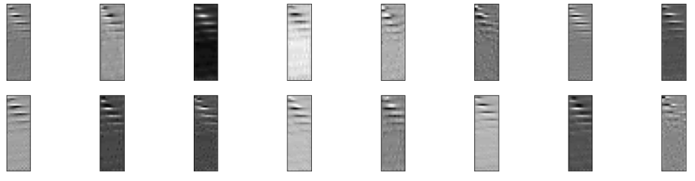
Model
11
Using the CNN
3. MY_ResNet
Avgpool(1,1, depth)이 들어있지 않은 My_ResNet 모델.

Slide 12
Result
12
1. Why using the CNN
2. Why select the kernel 2, 1, 4
3. How apply the image from sensor data

